Slide 1

Face recognition using PCA
R.SINDHI MADHURI
A.ANURAG REDDY
G.USHASWI
ROHIT UPADHYAY

Slide 2
CONTENTS
IDEA
OPERATIONS
MERITS
DEMERITS
APPLICATIONS

Slide 3
IDEA
PCA
Eigenfaces: the idea
Eigenvectors and Eigenvalues
Learning Eigenfaces from training sets of faces
Co-variance
Recognition and reconstruction

Slide 4
PCA
PCA means Principle Component Analysis.
PCA was invented in 1901 by Karl Pearson
PCA involves the calculation of the eigenvalue decomposition of a data covariance matrix or singular value decomposition of a data matrix, usually after mean centering the data for each attribute.

Slide 5
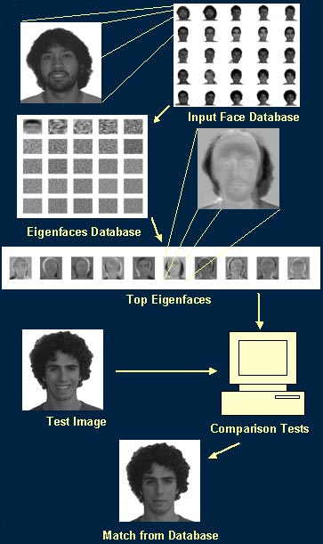
Algorithm
Three basic steps involved in PCA are:
Identification
{by eigen faces}
Recognition
{matching eigen faces}
Categorization
{by grouping}

Slide 6
EIGEN VECTORS
In Digital Image Processing, we convert 2-D images into matrix form for clear analysis.
Every matrix can be represented with the help of its eigen vectors.
An eigenvector is a vector that obeys the following rule:
Where A is a matrix , is a scalar (called the eigenvalue)
e.g. one eigenvector of is since
so for this eigenvector of this matrix the eigenvalue is 4

Slide 7
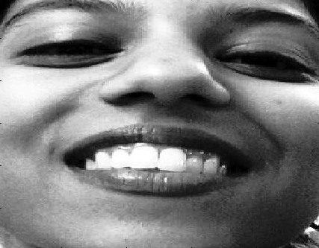
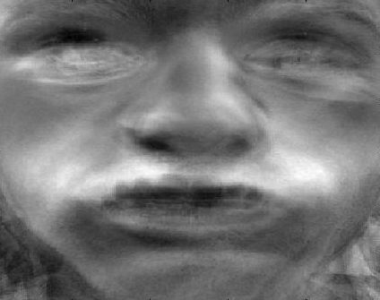
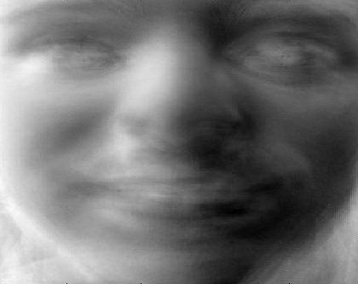
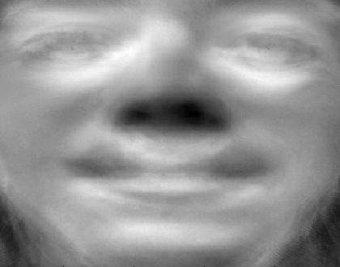
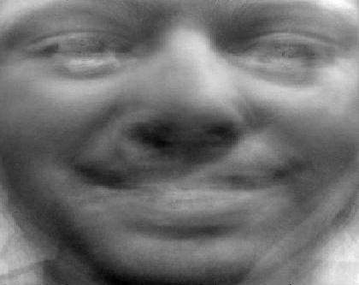
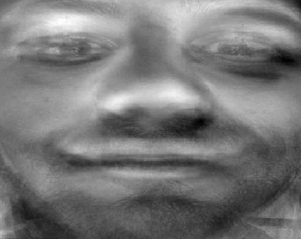
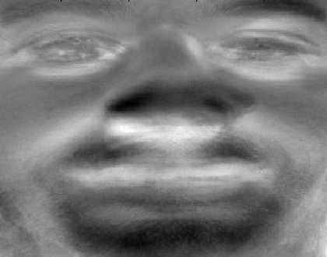
EIGEN FACES
Think of a face as being a weighted combination of some “component” or “basis” faces
These basis faces are called eigen faces.
-8029 2900 1751 1445 4238 6193

Slide 8
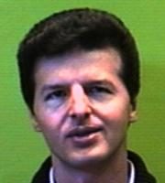
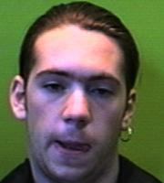
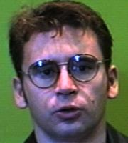
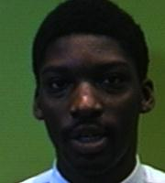
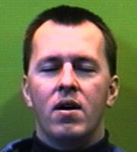
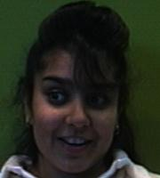
Eigenfaces: representing faces

Slide 9
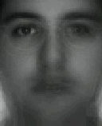
We compute the average face

Slide 10
Then subtract it from the training faces

Slide 11
Now we build the matrix which is N² by M
The covariance matrix which is N² by N²

Slide 12
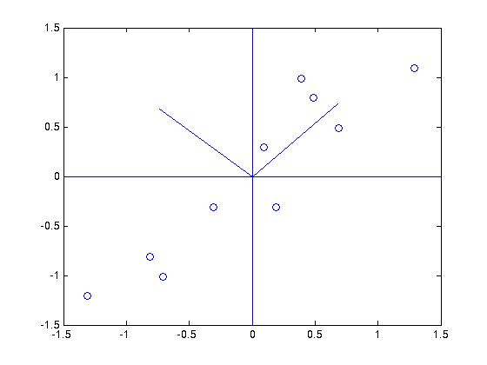
The covariance matrix has eigenvectors
covariance matrix
eigenvectors
eigenvalues
Eigenvectors with larger eigenvectors correspond to
directions in which the data varies more
Finding the eigenvectors and eigenvalues of the
covariance matrix for a set of data is termed
principle components analysis
The covariance of two variables is:

Slide 13
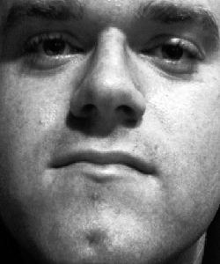
Recognition
A face image can be projected into this face space by
p_{k} = U^{T}(x_{k} – m) where k=1,…,m
To recognize a face
Subtract the average face from it

Slide 14
Compute its projection onto the face space U
Compute the distance in the face space between the face and all known faces
Compute the threshold

Slide 15
Distinguish between
If then it’s not a face; the distance between the face and its reconstruction is larger than threshold
If then it’s a new face
If then it’s a known face because the distance in the face space between the face and all known faces is larger than threshold

Slide 16
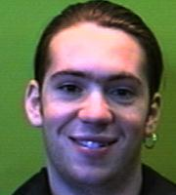
RECONSTRUCTION
Image is reconstructed in the 3rd case, if
Using the MATLAB code, original image and reconstructed image are shown.
Ex:

Slide 17
MERITS
Relatively simple
Fast
Robust
Expression
- Change in feature location and shape.

Slide 18
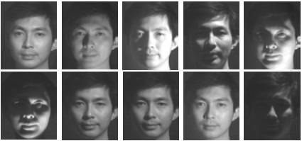
DEMERITS
Variations in lighting conditions
Different lighting conditions for enrolment and query.
Bright light causing image saturation.

Slide 19
APPLICATIONS:
Various potential applications, such as
Person identification.
Human-computer interaction.
Security systems.

Slide 20
Thank You

